Slide 1

PRESENTED BY -
AAMLEEN AHMED,
MOHD. SUFYAN AZAM
NETWORK SECURITY
RSA BASED PUBLIC CERTIFICATION AUTHORITY

Slide 2

INTRODUCTION
- RSA offers strong encryption that is resistant to brute-force attacks due to the difficulty of factoring large numbers.
- That is why RSA can be used to encrypt/decrypt the messages send by a certification authority
- RSA is used to create digital signatures, ensuring data integrity and authenticity. It is also widely used in various applications, including secure email, and online banking.
- In this mini-project, we completely implement the RSA based public key cryptosystem.

Slide 3
STRUCTURE OF CODEBASE
Certification_authority.py
Client.py
RSA.py

Slide 4
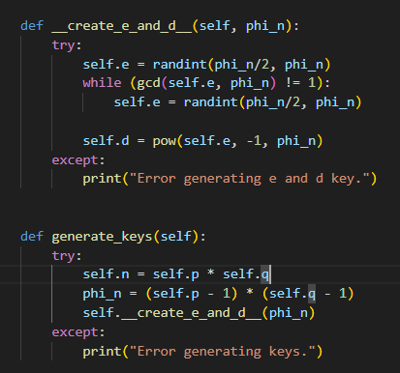
RSA.py
This file was used to implement the RSA algorithm.
A class called RSA was defined in it which had all the required functions and stored public/private keys.
By default the values of p and q are 229 and 31 respectively.
This class was imported in other files for use.
Key Generation

Slide 5
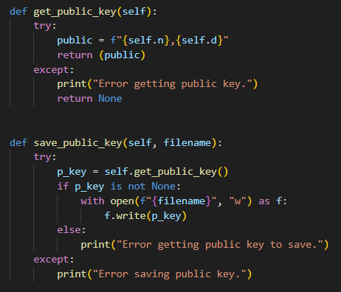
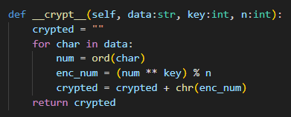
RSA.py
Encryption and Decryption Functions
Save and Load Public Keys

Slide 6
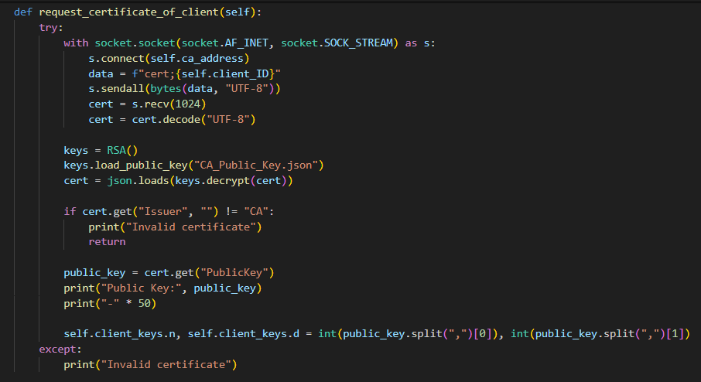
Client.py
This file was used to handle all the client functions that were needed for successfully requesting certificate from the Certification Authority and talking to the other clients.
An object of this class behaves as a client. Here, a RESPONDER variable is also set to the ID of the client that is going to respond to the request sent by the other client.
By default, the clients will send and receive ‘Hello’ and ‘ack’ for each successfull connection.
Certification Request

Slide 7
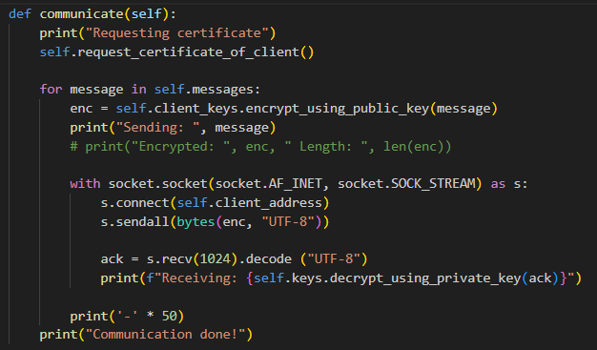
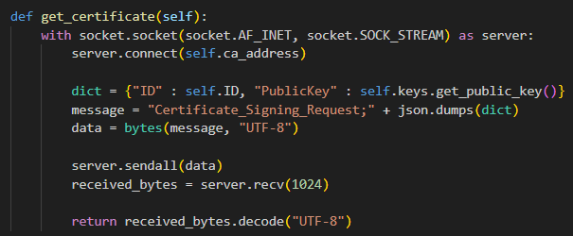
Client.py
Get Certificate Function
Communication Handler Function

Slide 8
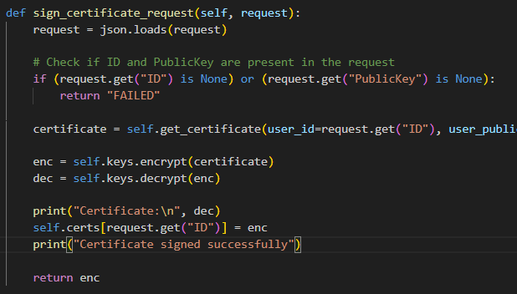
Certification_Authority.py
This file handles all the requests made by the client to give or sign the certificates of either the client that has made the request or the client that it needs the certificate to.
An object of this class creates a CA server which can respond to clients. Here, it will check if the certificate and public key is present or needs to be generated and acts accordingly.
It also checks the validity of the certificate of client present with itself and if the certificate is expired then it will re-generate a new one. The default validity period is 365 days.
Certificate signing request function

Slide 9
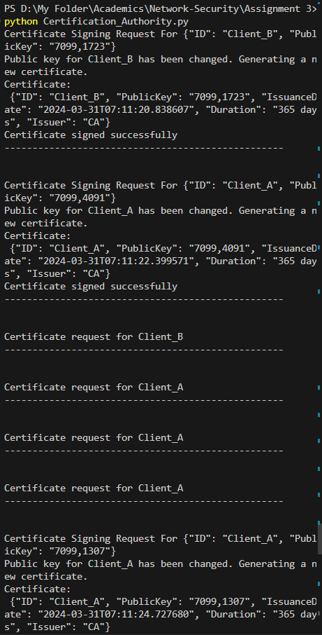
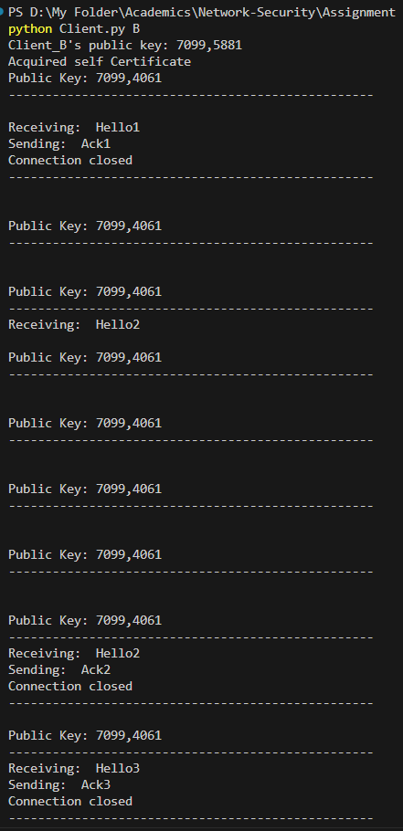
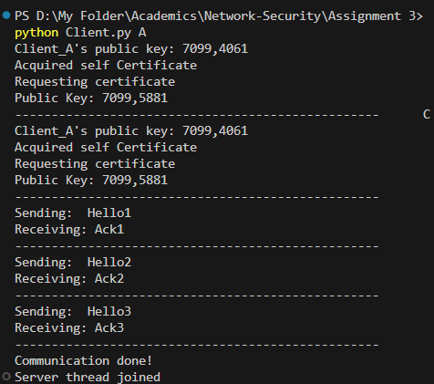
TESTING

Slide 10

PRESENTED BY
AAMLEEN AHMED (2020002)
MOHAMMAD SUFYAN AZAM (2020312)
THANK YOU VERY MUCH!
NETWORK SECURITY - PROJECT 3

